Slide 1
Software Quality Engineering
Week 6
Engr. Muhammad Umer Haroon

Slide 2

Use of Mobile (no)
Late coming (no)
Short Attendance (no)
Plagiarism (no)
Cheat (no)
Disrespect (no)

Slide 3
implementation

Slide 4
https://google.github.io/styleguide/cppguide.html
https://learn.microsoft.com/en-us/dotnet/csharp/fundamentals/coding-style/coding-conventions?redirectedfrom=MSDN
https://geosoft.no/javastyle.html
http://crockford.com/javascript/code.html
https://peps.python.org/pep-0008/
https://gist.github.com/ryansechrest/8138375#3-openclose-tag
PHP

Slide 5
Code
When it comes to development, certainly the most foremost concern is whether or not it works. But beyond that, there are a number of other factors that we will consider when we talk about is the code good?
One of the most important parts of implementation could be coding style.

Slide 6
Readability
Maintainability
Testability
Helps Focus on logic
Scalability
Reusability

Slide 7
A well-written code is not just one that performs its intended task accurately, but also one that is easy to read, understand, and maintain.
What we want to be able to do with coding style is enforce a coding style guide, a set of rules for formatting code across the entire team.

Slide 8
Consistency is the key
Variable vs Routine name
varaible_name vs RoutineName()
Class vs Object
Widget vs my_widget

Slide 9
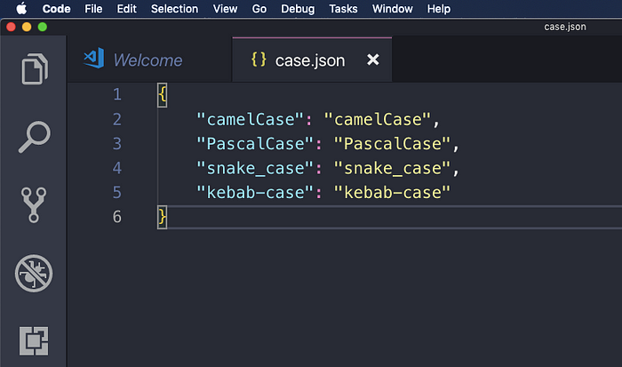
Naming conventions styles
camelCase
PascalCase
snake_case
kebab-case

Slide 10
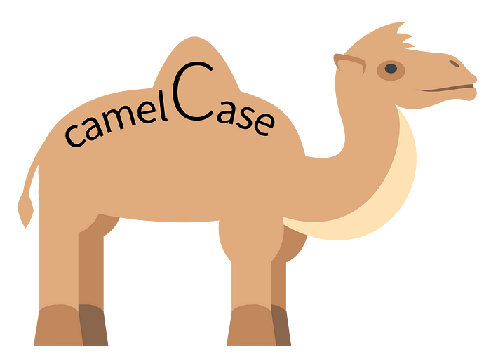
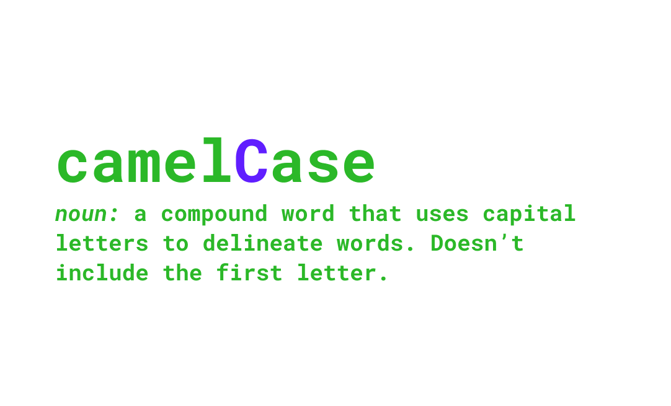

Slide 11

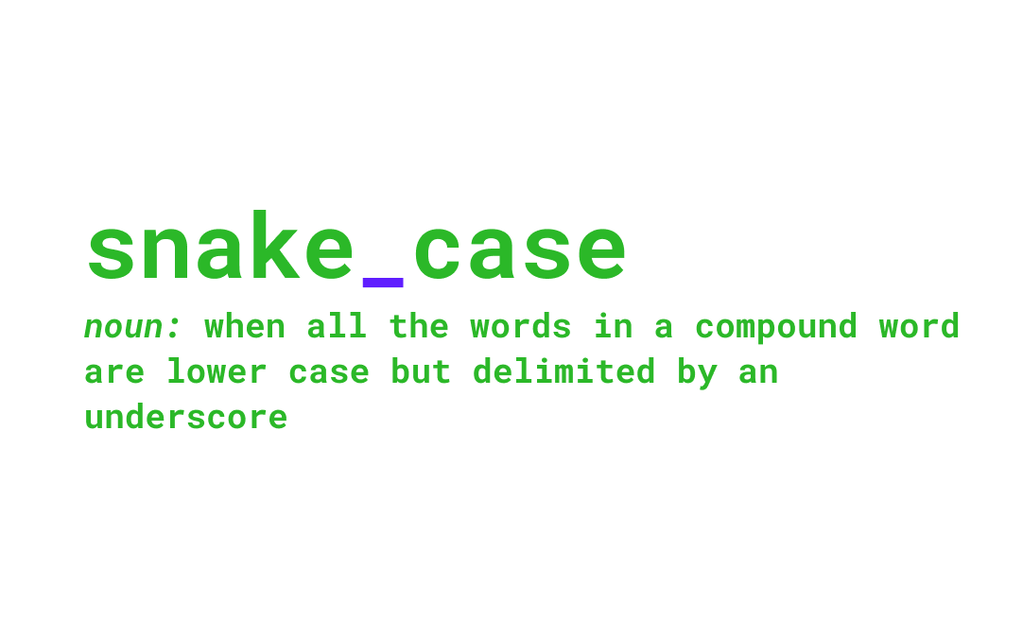

Slide 12

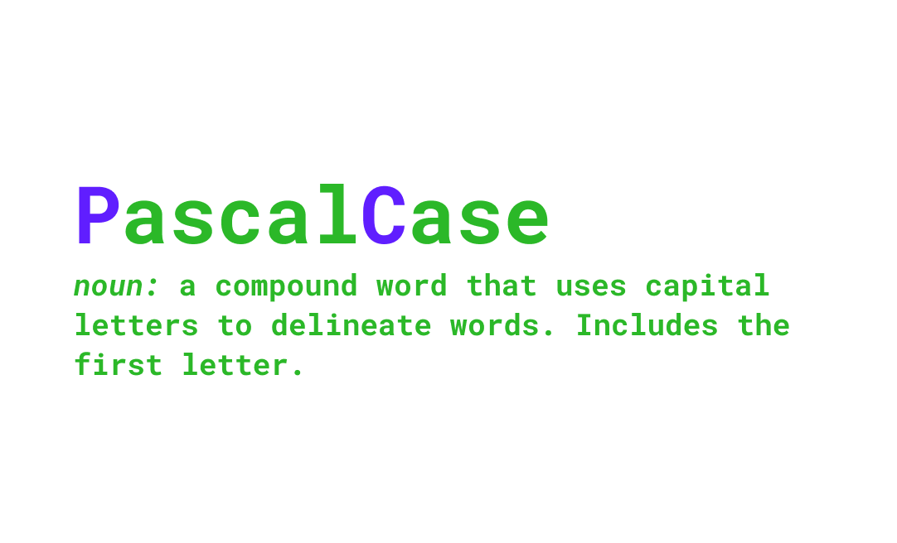

Slide 13
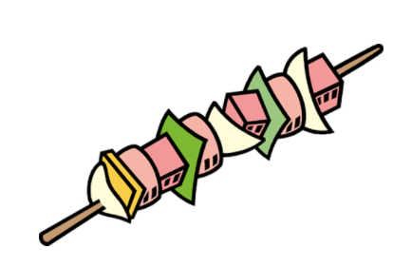
Kebab case is the way to write compound words separated by hyphens (-) instead of using space. Generally, everything is written in lowercase.
Example: “what-is-kebab-case”.
This writing style is widely used in SEO
(Search Engine Optimization — technique used by
software developers to optimize search engines) to
create a “slug” in URLs.
For example: www.xyx.com/home/user-profile

Slide 14
Write it down in different coding styles
class Dog extends Animal {
public function makesound() {
echo "Woof! \n";
}
}

Slide 15
File and folder Naming and Organization
Should not have spaces , it works in windows but not other platforms.
So if you move from Windows to Linux, Windows to Mac, potentially, those files with spaces in the middle will cause lots of programs and scripts to fail.
So if you move from Windows to Linux, Windows to Mac, potentially, those files with spaces in the middle will cause lots of programs and scripts to fail.

Slide 16
File extensions
.cc vs .cpp
.htm vs .html

Slide 17
Formatting and Indentation
Spaces vs Tabs
Perhaps neither spaces or tabs should be in source code other than spaces to separate symbols. The source code editor should be able to style the source text independently of the meaningful code based on styling rules than can be specified by the user of the editor.

Slide 18
Placement of braces
K&R
one total bracket system1TBS,
and Allman.

Slide 19
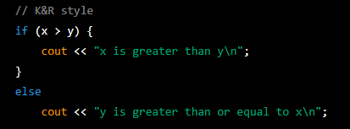
Examples might be wrong
Look for correct your self

Slide 20
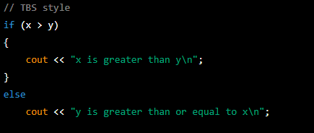
Examples might be wrong
Look for correct your self

Slide 21
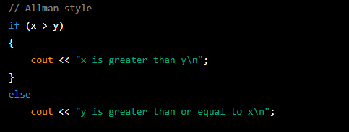
Examples might be wrong
Look for correct your self

Slide 22
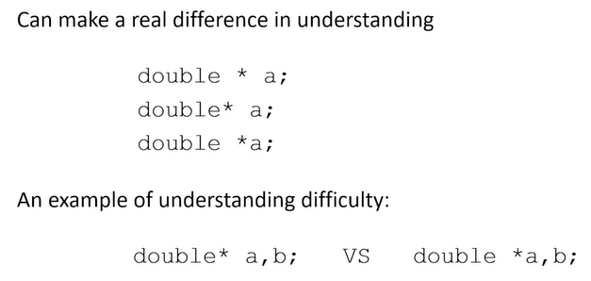
White spaces
//C++

Slide 23
Bad Coding Standards
Imposing coding standards from one language on another.
Not commenting your code/documentation.
Using the wrong tool for the job.
Not bothering with mastering your tools and IDE

Slide 24
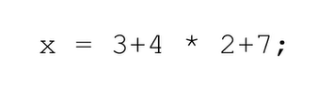
examples

Slide 25
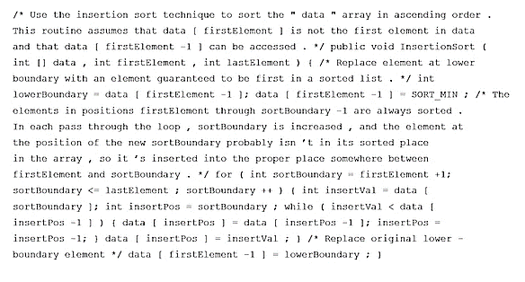

Slide 26
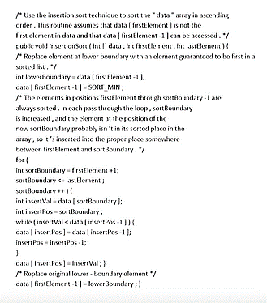

Slide 27
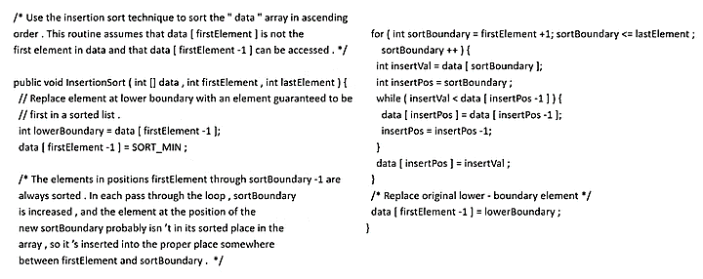

Slide 28
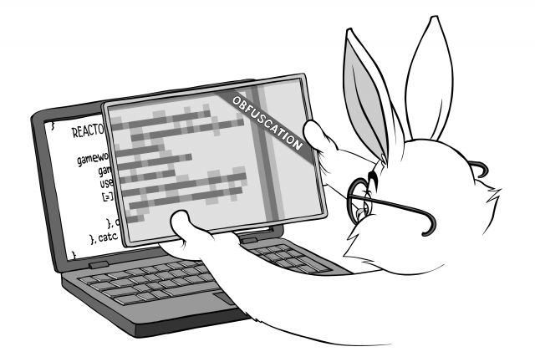
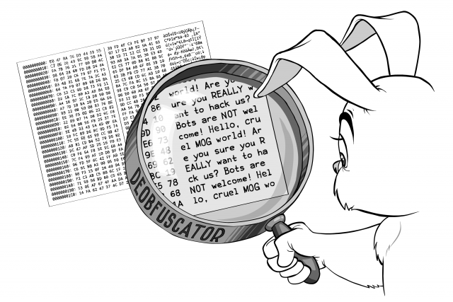
Obfuscation / DE obfuscation

Slide 29
Maintenance and Debugging: Obfuscated code is typically more difficult to understand and modify, which can make maintenance and debugging more time-consuming and error-prone. This can lead to longer development cycles and increased costs.
Performance: Some obfuscation techniques can impact the performance of the software, either by introducing additional overhead or by making the code less efficient. This can result in slower or less responsive software.
Readability and Comprehension: Obfuscated code can be difficult to read and comprehend, which can make it more challenging for developers to understand how the software works. This can lead to lower quality code, as developers may be more likely to introduce errors or unintended behavior.
Testing: Obfuscation can make it more difficult to test software, as the code may be more difficult to understand and verify. This can result in lower quality testing and potentially missed defects.
Security: Although obfuscation can be used to protect intellectual property, it is generally not an effective security measure on its own. Malicious actors may still be able to reverse engineer or exploit the software, even if the code is obfuscated.

Slide 30
Self-documenting code is ostensibly written using human-readable names, typically consisting of a phrase in a human language which reflects the symbol's meaning, such as article.

Slide 31
Open code file…..

Slide 32
vcs
https://docs.github.com/en/get-started/using-git/about-git

Slide 33
VCS
A version control system, or VCS, tracks the history of changes as people and teams collaborate on projects together. As developers make changes to the project, any earlier version of the project can be recovered at any time.

Slide 34
How does version control system ensure quality of codes?
Version control software keeps track of every modification to the code in a special kind of database. If a mistake is made, developers can turn back the clock and compare earlier versions of the code to help fix the mistake while minimizing disruption to all team members.

Slide 35
Developers can review project history to find out:
Which changes were made?
Who made the changes?
When were the changes made?
Why were changes needed?

Slide 36
VCSs give each contributor a unified and consistent view of a project, surfacing work that's already in progress. Seeing a transparent history of changes, who made them, and how they contribute to the development of a project helps team members stay aligned while working independently.

Slide 37
Types of VCS
There are two types of VCS, namely:
Centralized version control system (CVCS),
Distributed version control system (DVCS).
Examples:
Open source -> Concurrent Versions System (CVS), Subversion (SVN).
Proprietary -> TeamCity, Vault, IBM Configuration Management Version Control (CMVC).
Examples:
Open source - Git, Mercurial, Bazaar.
Proprietary - Visual Studio Team Services, Plastic SCM.

Slide 38
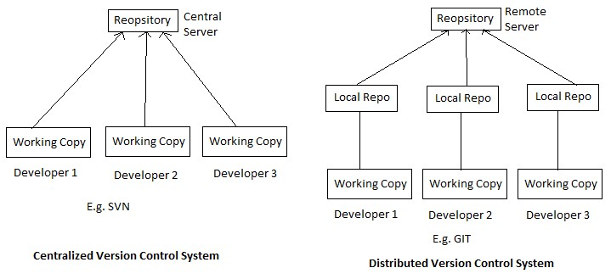

Slide 39
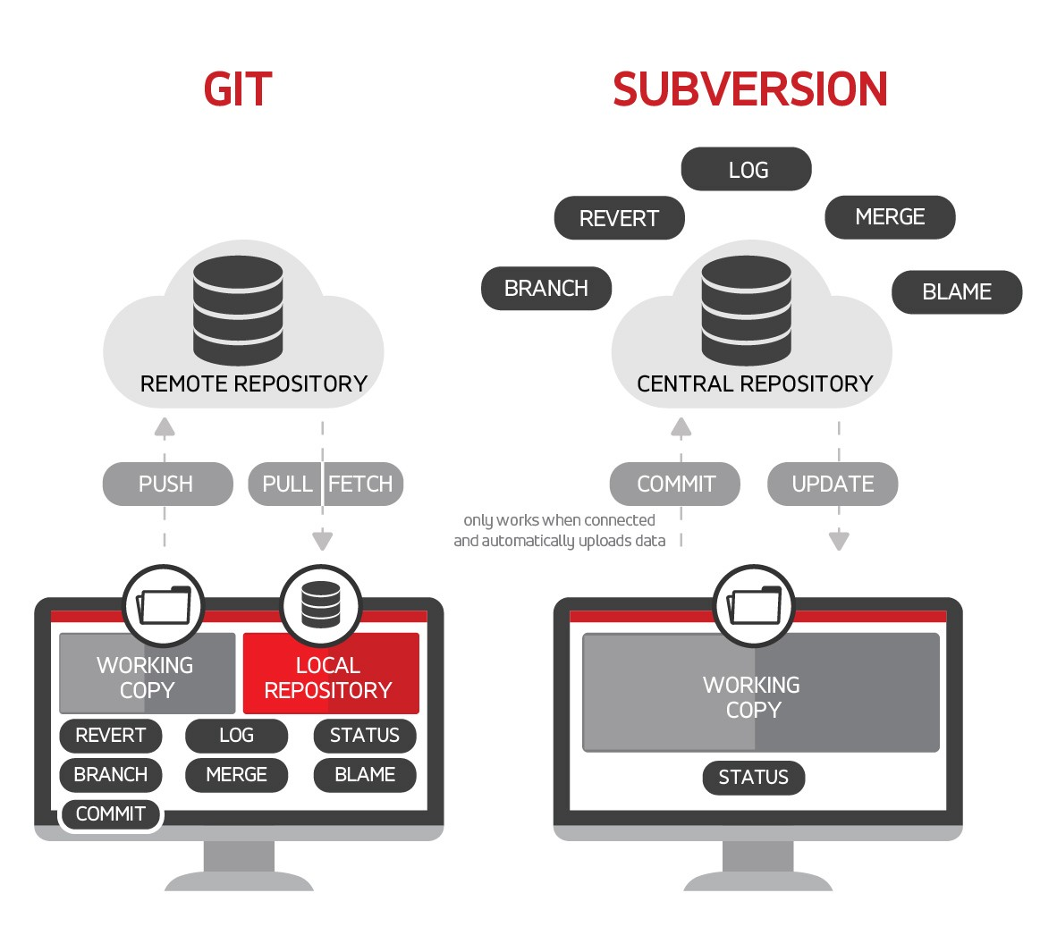

Slide 40
In a distributed version control system, every developer has a full copy of the project and project history.
Unlike once popular centralized version control systems, DVCSs don't need a constant connection to a central repository.
Git is the most popular distributed version control system. Git is commonly used for both open source and commercial software development, with significant benefits for individuals, teams and businesses.
Developers work in every time zone. With a DVCS like Git, collaboration can happen any time while maintaining source code integrity. Using branches, developers can safely propose changes to production code.

Slide 41
Git vs GitHub
Git is a version control system that lets you manage and keep track of your source code history. GitHub is a cloud-based hosting service that lets you manage Git repositories.

Slide 42
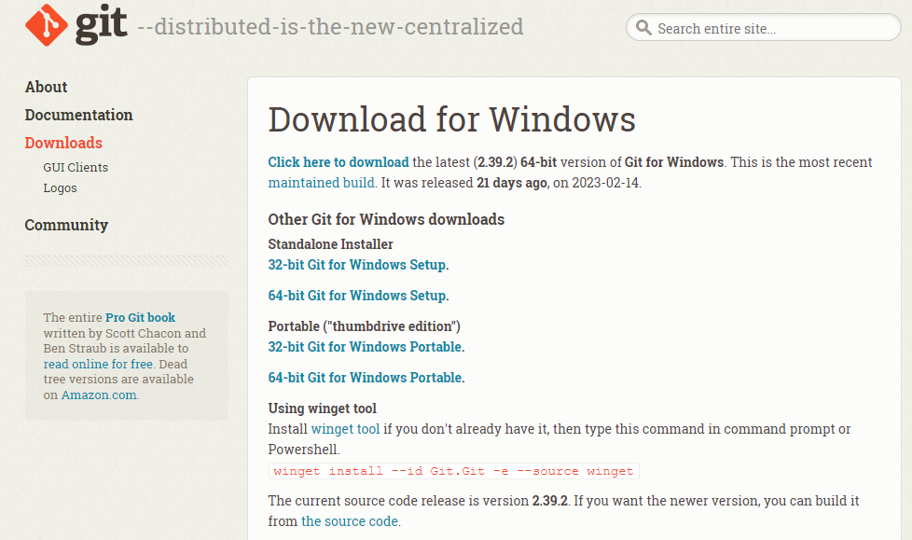
https://git-scm.com/download/win

Slide 43
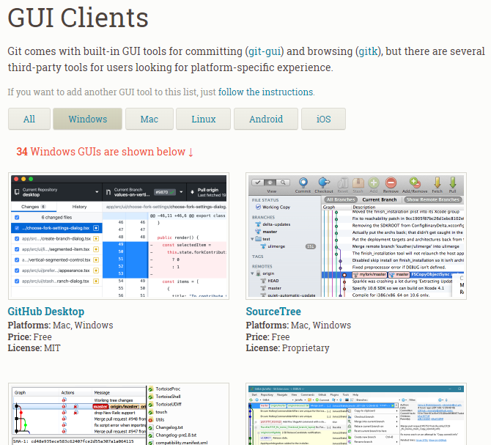
https://git-scm.com/download/gui/windows

Slide 44
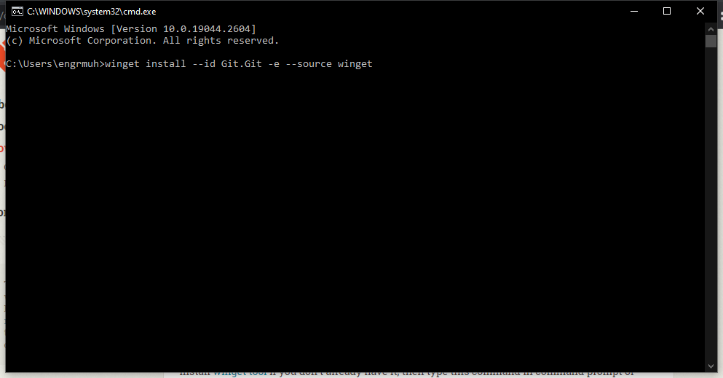

Slide 45
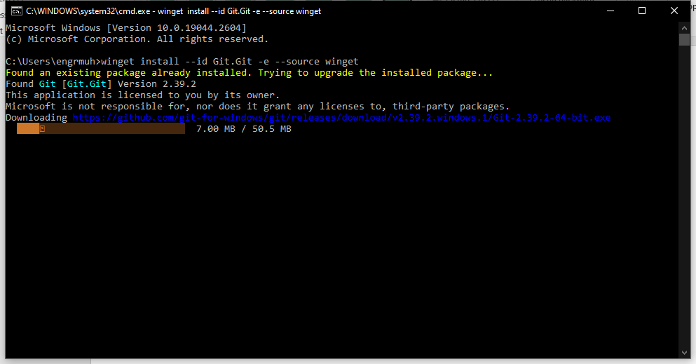

Slide 46
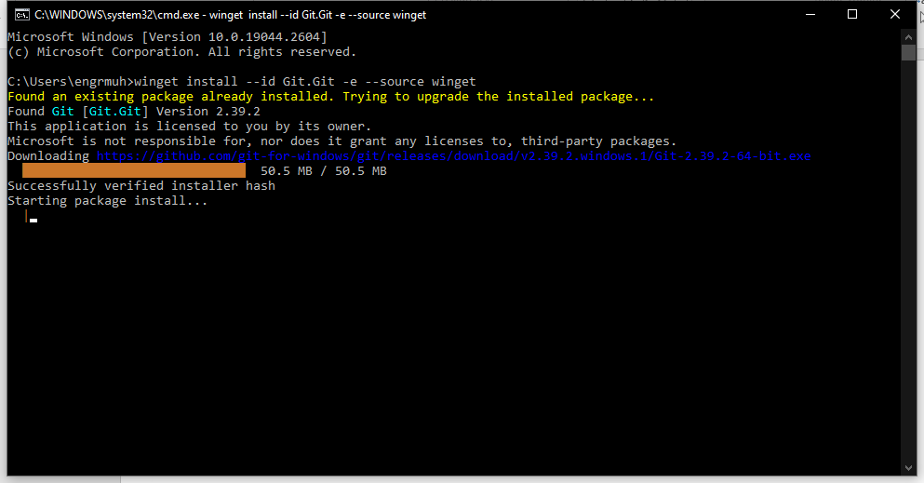

Slide 47
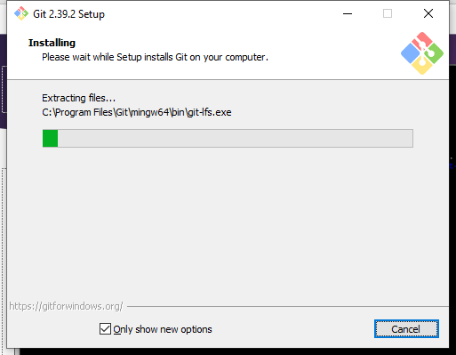

Slide 48
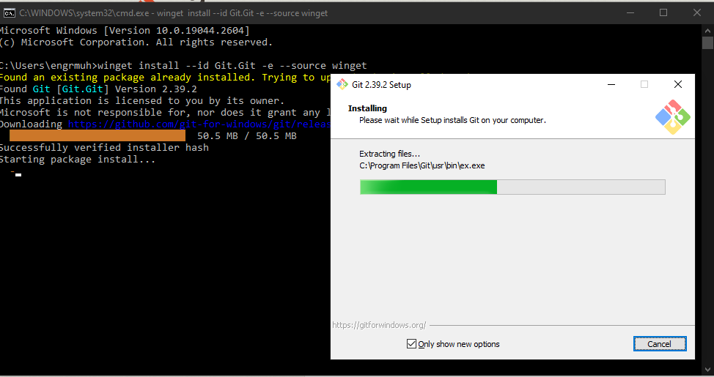

Slide 49
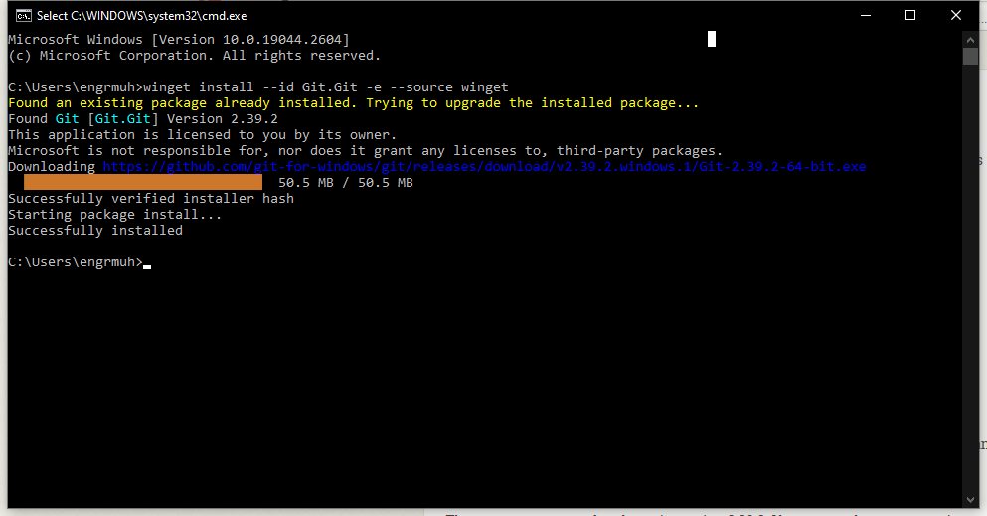

Slide 50
Vs code ----- > gitlens extension

Slide 51
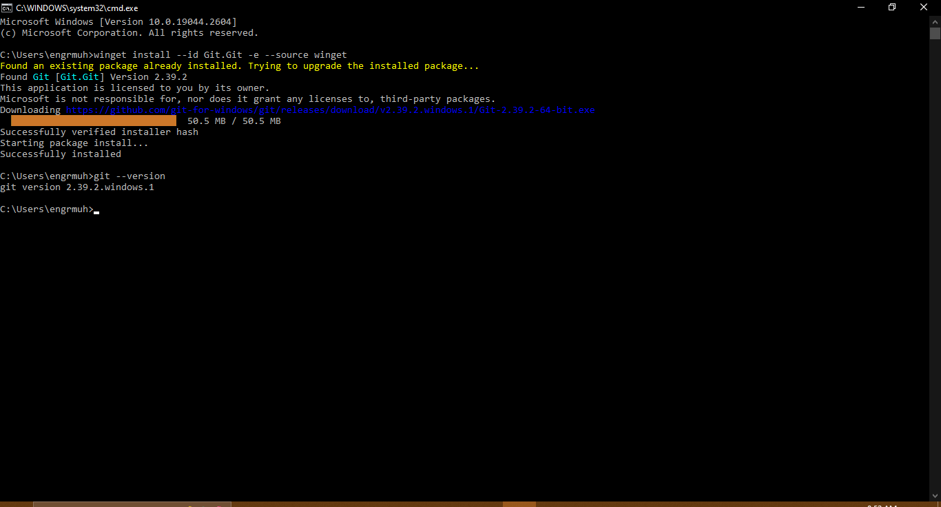

Slide 52
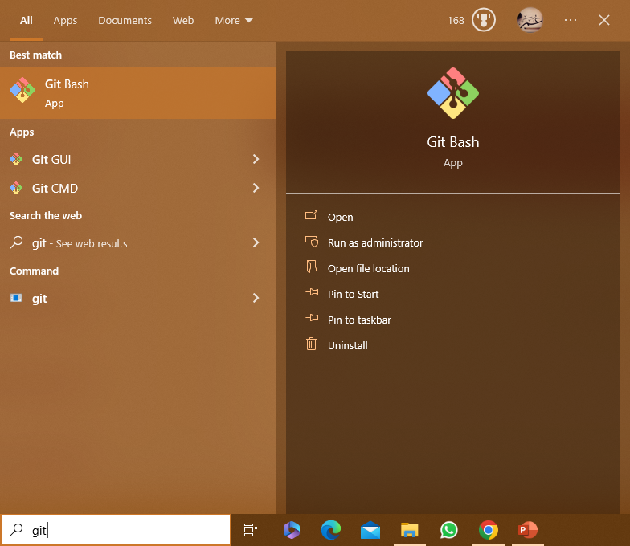

Slide 53
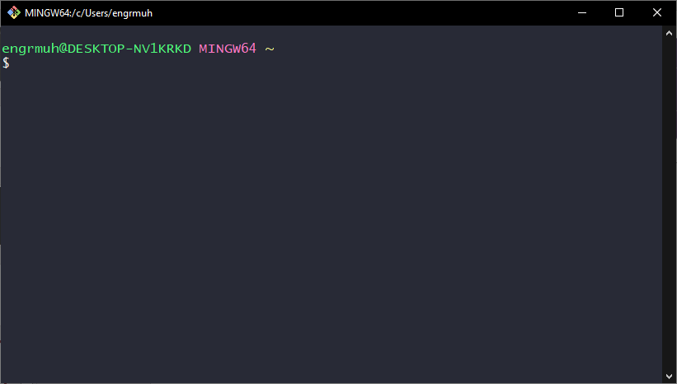

Slide 54
Git Configuration

Slide 55
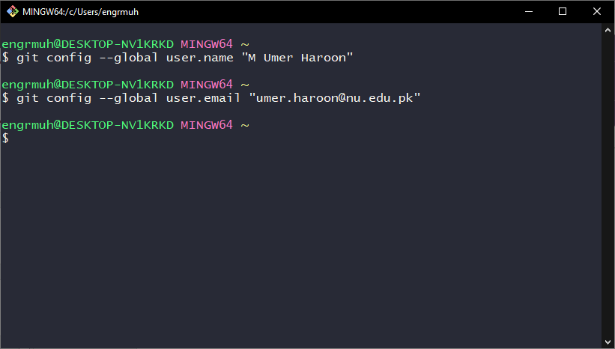

Slide 56
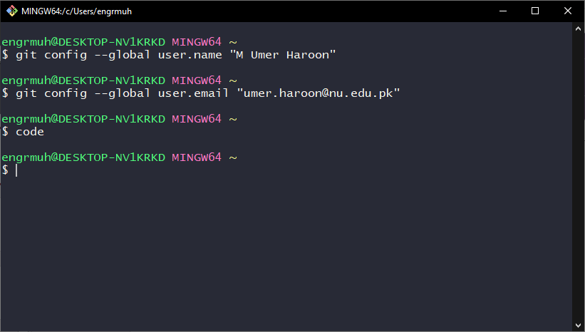
Code command opens
Visual studio code

Slide 57
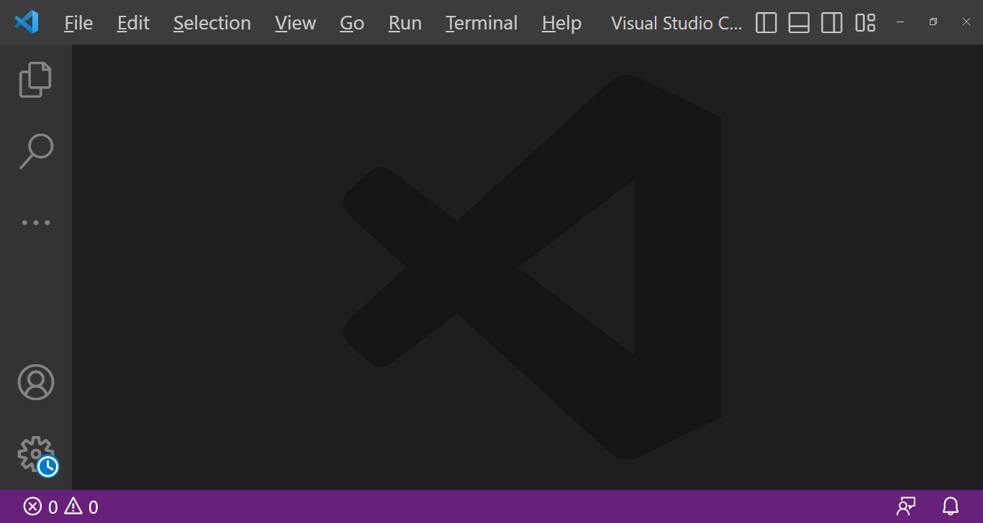

Slide 58
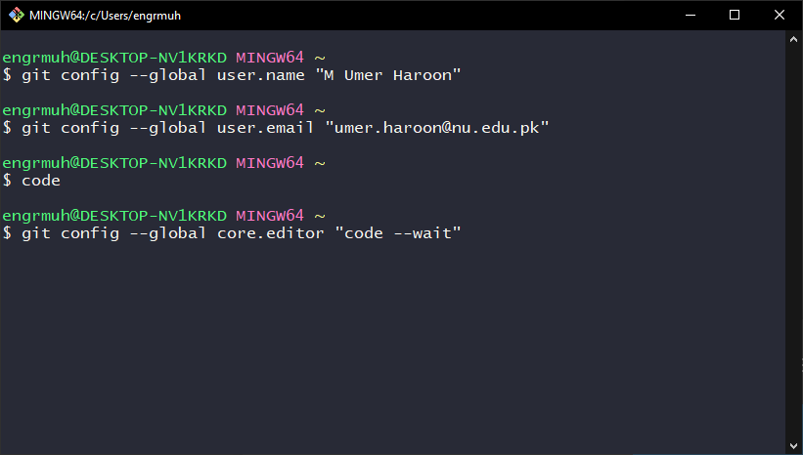
https://digitalthoughtdisruption.com/2020/09/08/make-vs-code-default-editor-in-git-post-install/
Code –wait
–wait – make sure git bash
will wait for code editor
will be closed

Slide 59
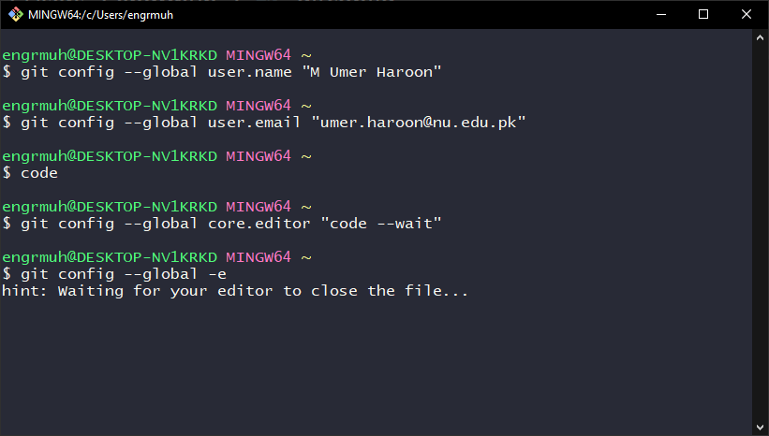

Slide 60
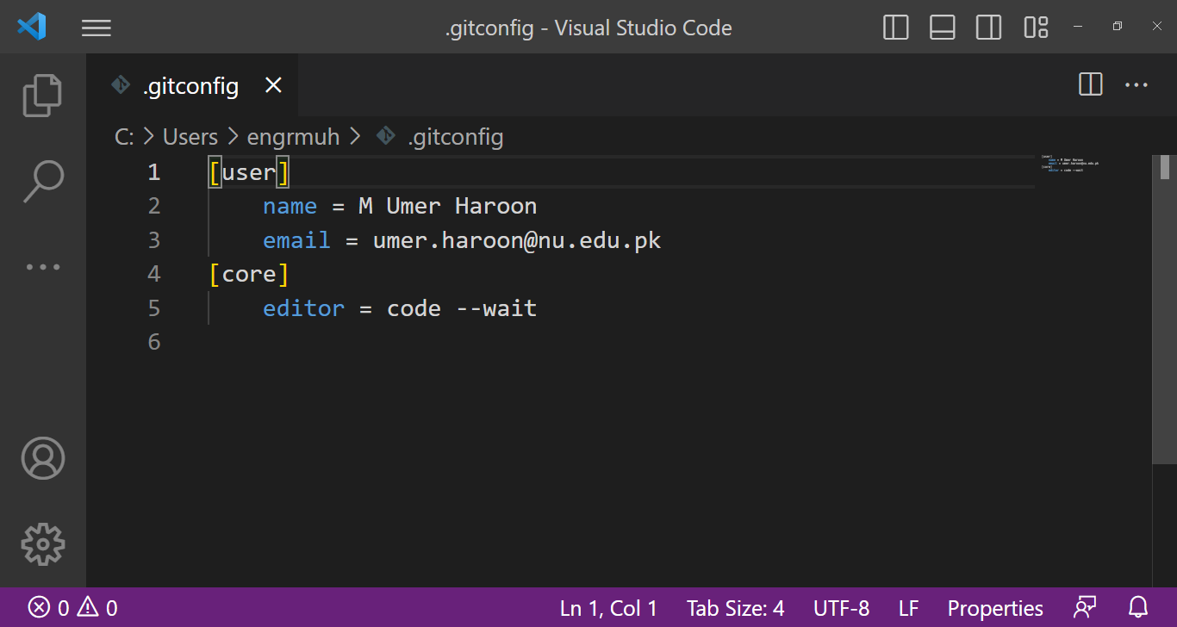

Slide 61
https://git-scm.com/book/en/v2/Customizing-Git-Git-Configuration
CRLF refers to the special character elements "Carriage Return" and "Line Feed."

Slide 62
If you’re programming on Windows and working with people who are not (or vice-versa), you’ll probably run into line-ending issues at some point. This is because Windows uses both a carriage-return character and a linefeed character for newlines in its files, whereas macOS and Linux systems use only the linefeed character. This is a subtle but incredibly annoying fact of cross-platform work; many editors on Windows silently replace existing LF-style line endings with CRLF, or insert both line-ending characters when the user hits the enter key.

Slide 63
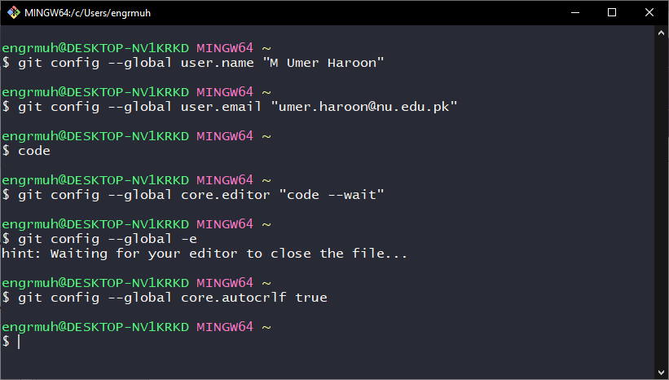
When using mac or linux
Instead of true write
input

Slide 64
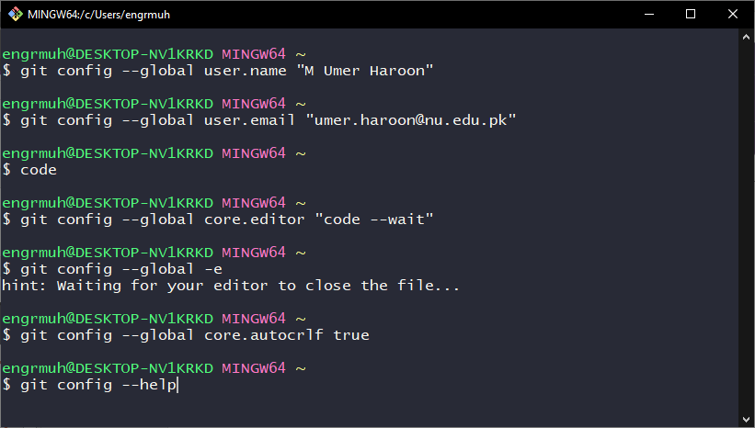
Help in git

Slide 65
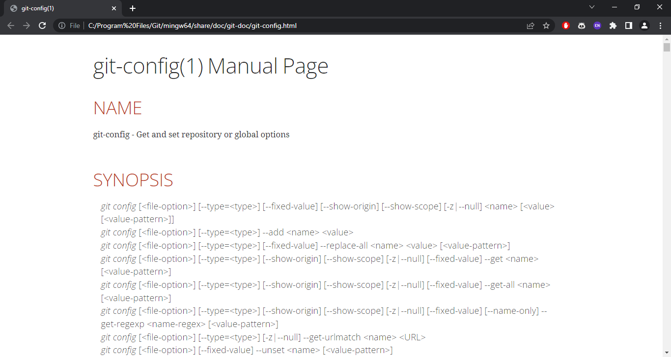

Slide 66
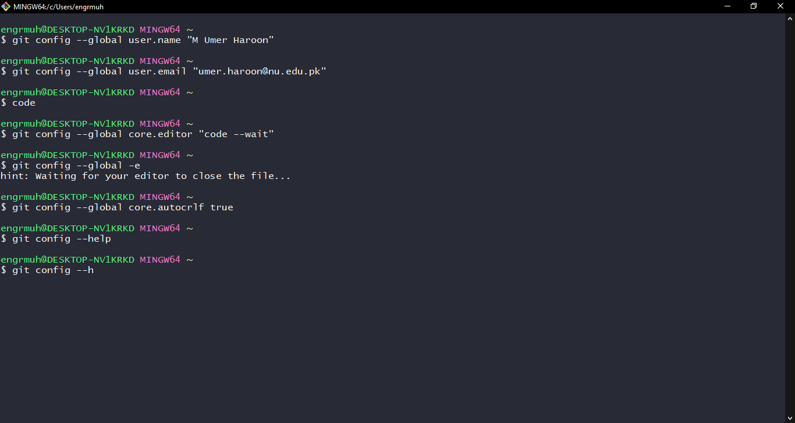

Slide 67
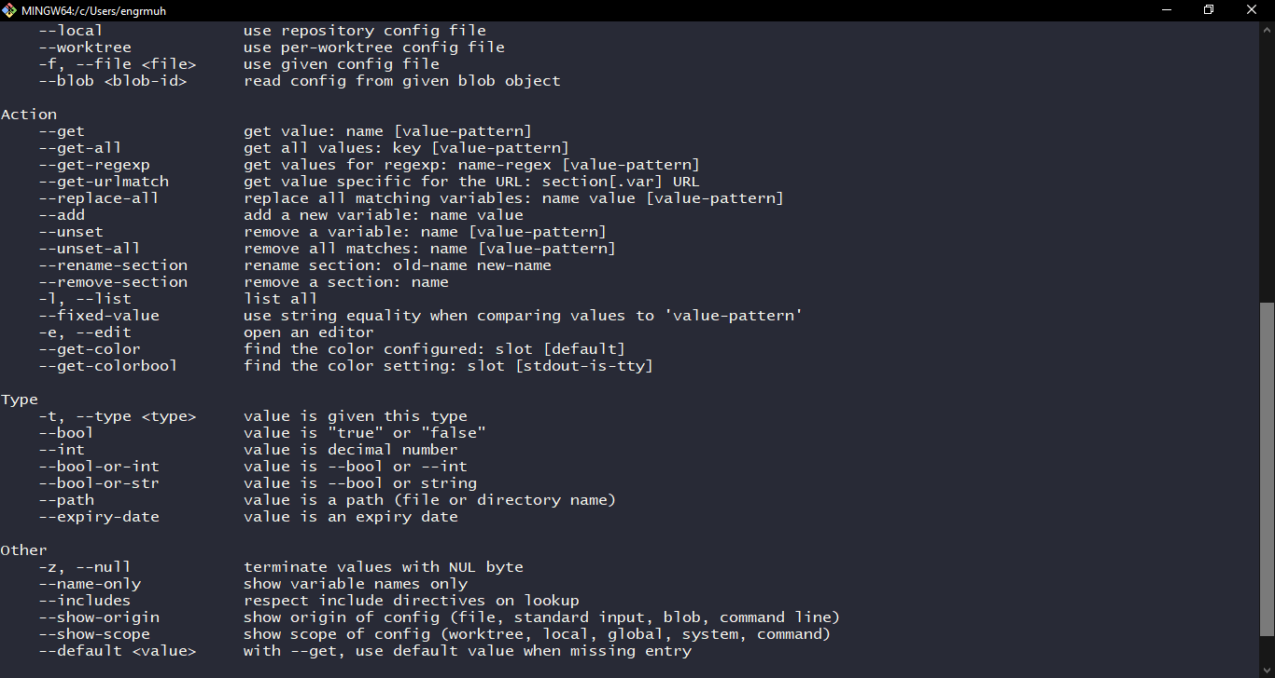

Slide 68
Repository

Slide 69
Repository
A repository, or Git project, encompasses the entire collection of files and folders associated with a project, along with each file's revision history.

Slide 70
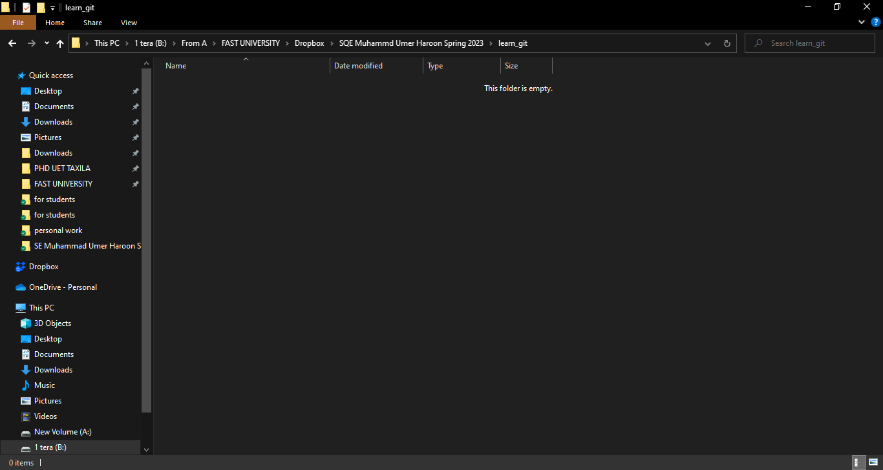

Slide 71
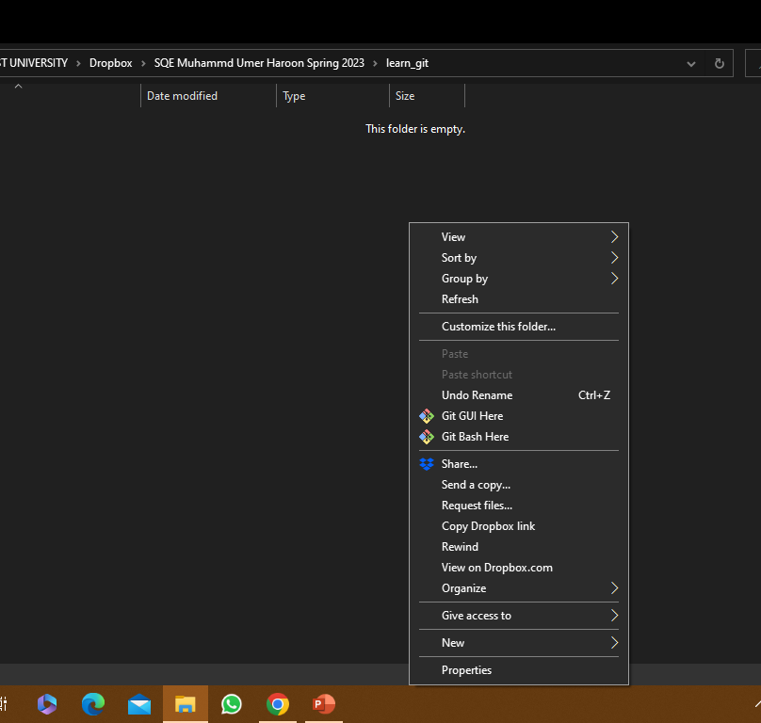

Slide 72
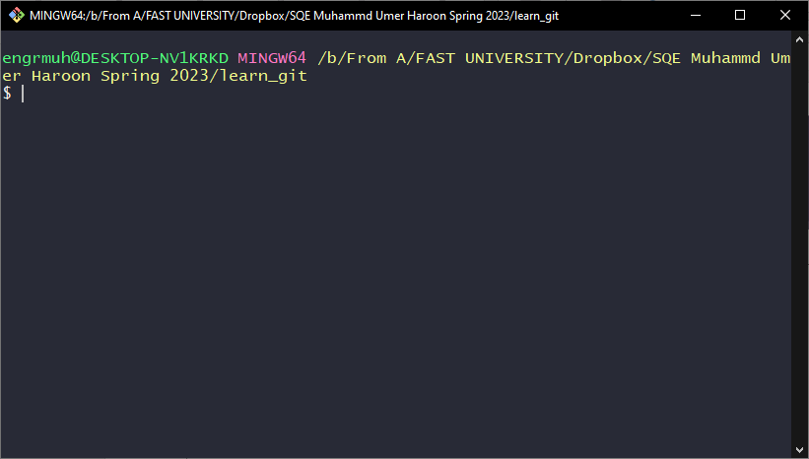

Slide 73
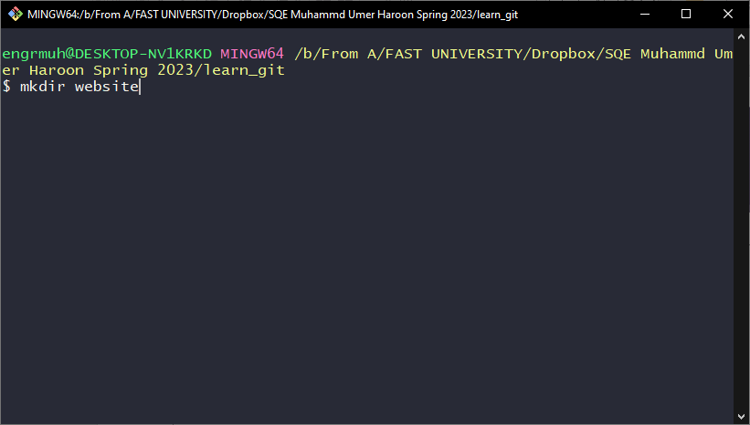
Assume we work
On a project called
Website

Slide 74
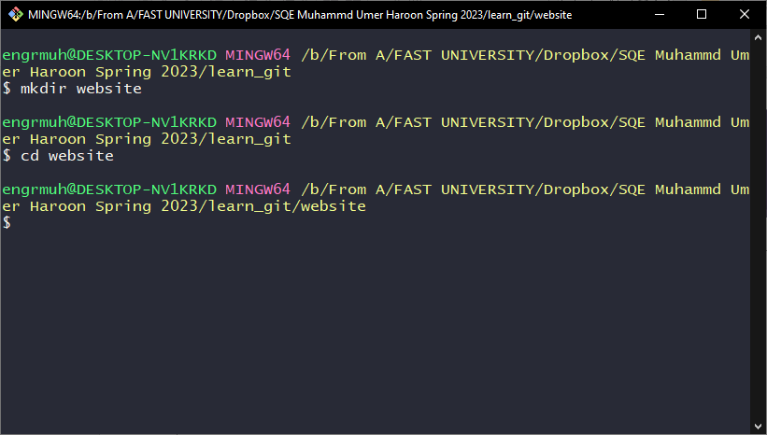

Slide 75
Git init
The git init command creates a new Git repository. It can be used to convert an existing, unversioned project to a Git repository or initialize a new, empty repository. Most other Git commands are not available outside of an initialized repository, so this is usually the first command you'll run in a new project.

Slide 76
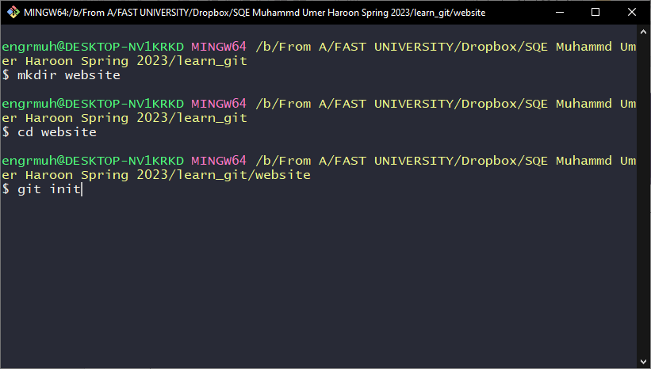

Slide 77
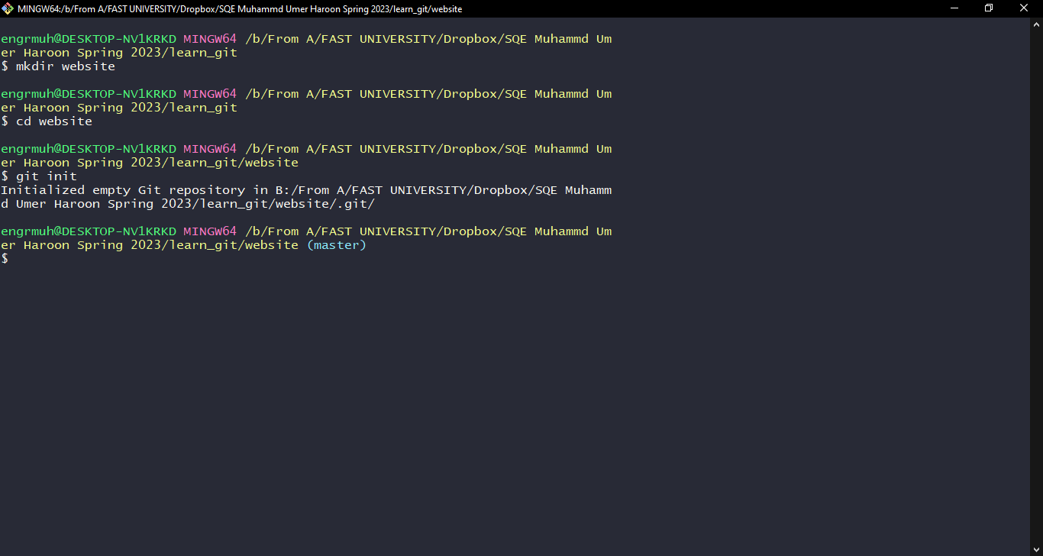
The master branch is a default branch in Git.

Slide 78
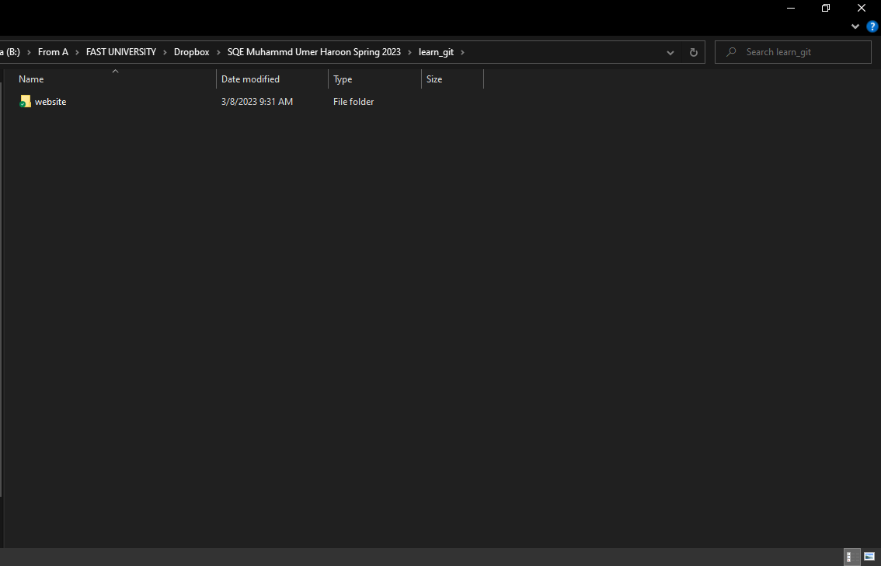

Slide 79
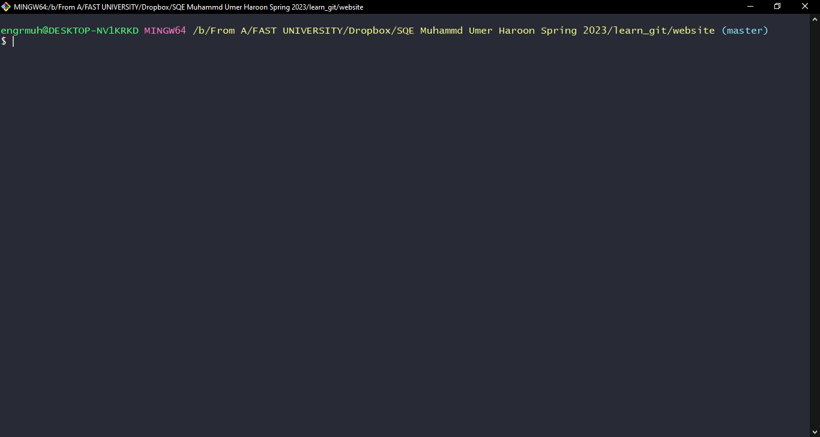
Clear
This command will clear the output buffer on git bash

Slide 80
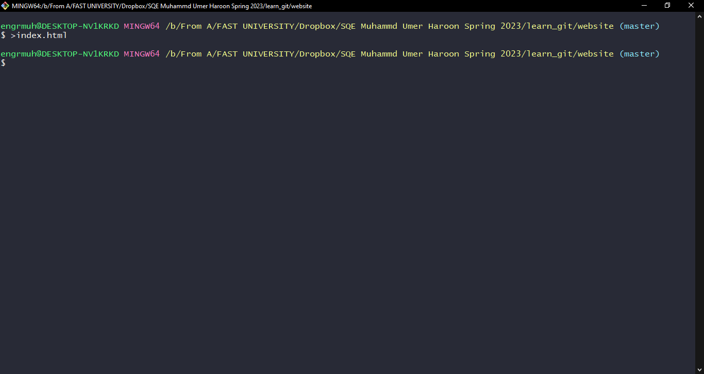

Slide 81


Slide 82


Slide 83


Slide 84


Slide 85
The git status command displays the state of the working directory and the staging area. It lets you see which changes have been staged, which haven't, and which files aren't being tracked by Git. Status output does not show you any information regarding the committed project history.
git status

Slide 86


Slide 87
Commit ?
Stagging area ?

Slide 88
Staging area
These files are also referred to as "untracked files." Staging area is files that are going to be a part of the next commit, which lets git know what changes in the file are going to occur for the next commit.

Slide 89
Git add
The git add command adds a change in the working directory to the staging area. It tells Git that you want to include updates to a particular file in the next commit. However, git add doesn't really affect the repository in any significant way—changes are not actually recorded until you run git commit .

Slide 90

Add one file at a time

Slide 91

Add multiple files at a time

Slide 92

Add multiple files having a specific extension

Slide 93

Add every file from directory / not recommended (explore why ?)

Slide 95


Slide 96

These files are in staging area

Slide 97

Make some changes to file

Slide 98

Run git status command

Slide 99


Slide 100


Slide 101


Slide 102


Slide 103


Slide 104

Staging area at times called index

Slide 105
commit

Slide 106
Git commit
The git commit command captures a snapshot of the project's currently staged changes. Committed snapshots can be thought of as “safe” versions of a project

Slide 107

-m is for message
Insertion means no
Of lines inserted

Slide 108
Every commit should be done after accomplishing some logical changes.
-m message will be visible to all people working on project , so be wise about it.

Slide 109


Slide 110

-a means all files that have
Been modified in this case
It is a single file.
Here we are skipping add
Command (means no
Staging :not recommended
)and directly Committing

Slide 111

Deletion is appearing
Because I manually
Created a notepad file
And deleted it using
Windows explorer earlier.

Slide 112

Remove about file
For whatever reasons

Slide 113


Slide 114


Slide 115

File is removed from working directory but still in staging area.
-ls means list

Slide 116

now the changes will be staged

Slide 117


Slide 118


Slide 119


Slide 120


Slide 121


Slide 122
If we type
git rm example.html
It will remove from directory as well as staging area , (in this case no need of add command and then commit command).

Slide 123


Slide 124


Slide 125


Slide 126
mv
Git move or mv helps us to rename or move files within a git repository without deleting its history. If we move or rename a file within a git repository then it thinks that a file is deleted and a new file is added.

Slide 127


Slide 128


Slide 129


Slide 130


Slide 131

Error due to space
- m

Slide 132


Slide 133
Git log

Slide 134
The git log command shows a default output for quickly reviewing the commit history. The default output includes the commit ID, commit author, developer email, commit date and commit message string for each commit on the active branch.

Slide 135


Slide 136


Slide 137

The oneline option is used to display the output as one commit per line. It also shows the output in brief

Slide 138


Slide 139

--reverse changes order

Slide 140
What have we changed in a commit

Slide 141

git show

Slide 142

Using commit id

Slide 143


Slide 144
Git restore (simply undo)

Slide 145
The "restore" command helps to unstage or even discard uncommitted local changes.

Slide 146


Slide 147

Some changes to contact file

Slide 148


Slide 149
The changes are not in staging area , only in working directory.

Slide 150

restore

Slide 151


Slide 152
Assignment 2…………………………

Slide 153


